Slide 1
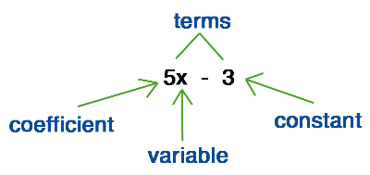
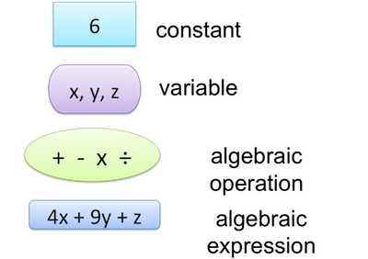
My Algebra Interactive Notebook
Name
Class
Teacher Mr Evans
Term 2 Semester 1
1

Slide 2
Contents
Glossary or Formula Page
Page
Date
Description
2
3

Slide 3
Tasks
24
7
30
Essential Question
Questions
Notes
Summary

Slide 4
24
7
30
Date
Like Terms
EQ – What is an expression and how do we write them?
We know that ab and ba are the same thing, so we can do sums
like
4ab + 5ba =
9ab
7xy + 9yx =
16xy
3abc – 2bca + 8cab =
9abc
mnp – 2mpn – 7pmn =
– 8mnp
Note that in each case,
the number goes first
alphabetical order is used for the answer (though it
is still correct to write 9ba, 16yx etc…)

Slide 5
24
7
30
Date
Like Terms
EQ – What is an expression and how do we write them?
We know that ab and ba are the same thing, so we can do sums
like
4ab + 5ba =
9ab
7xy + 9yx =
16xy
3abc – 2bca + 8cab =
9abc
mnp – 2mpn – 7pmn =
– 8mnp
Note that in each case,
the number goes first
alphabetical order is used for the answer (though it
is still correct to write 9ba, 16yx etc…)
What is the difference between Like and Unlike Terms?
6a + 7a is an example of LIKE TERMS.
Like terms can be added or subtracted to get a simpler answer (13a in this case)

Slide 6
24
7
30
Date
Like Terms
EQ – What is an expression and how do we write them?
What is the difference between Like and Unlike Terms?
6a + 7a is an example of LIKE TERMS.
Like terms can be added or subtracted to get a simpler answer (13a in this case)
6a + 7b is an example of UNLIKE TERMS.
Unlike terms cannot be added or subtracted.

Slide 7
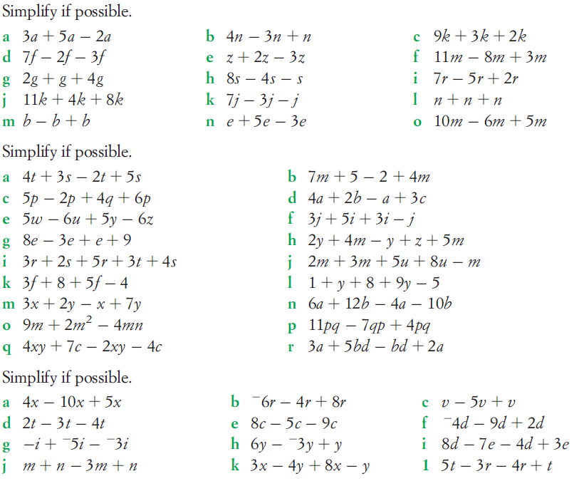
Task

Slide 8
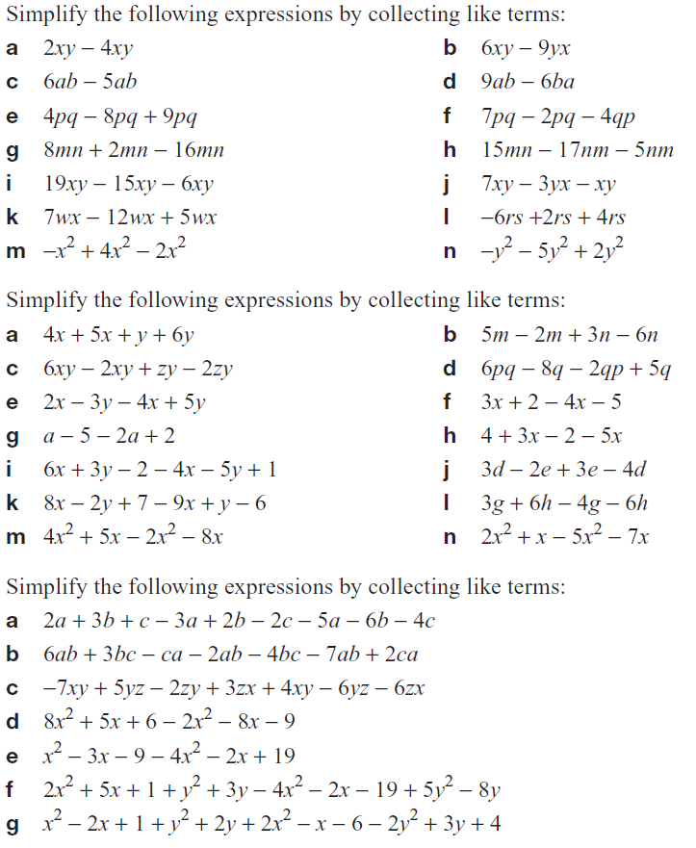
Task

Slide 9
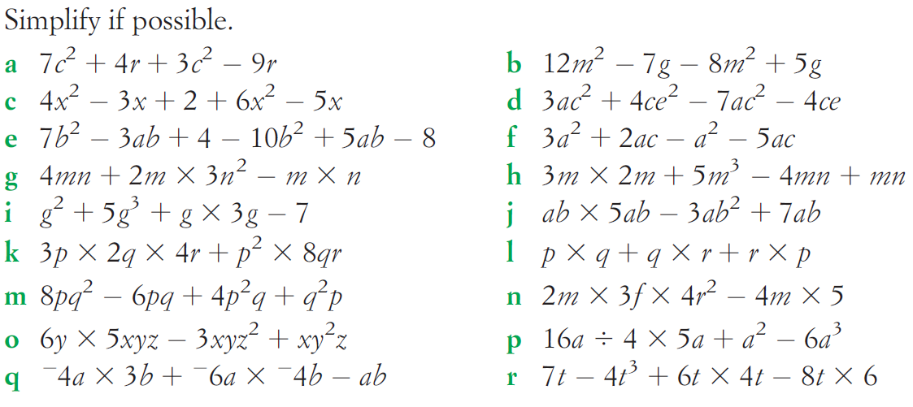
Task

Slide 10
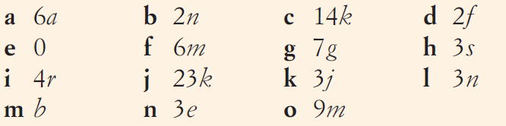
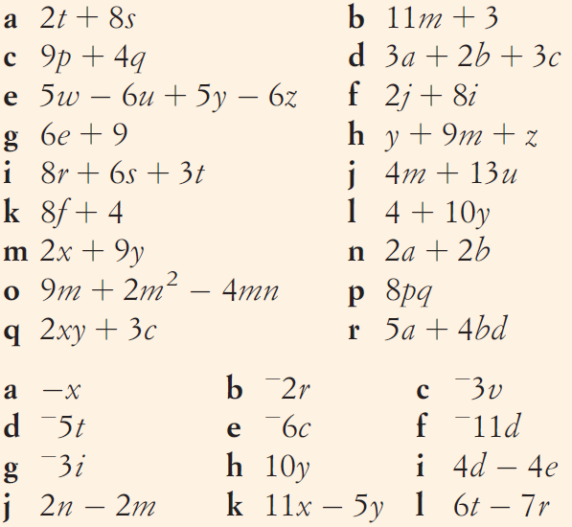
Answers

Slide 11

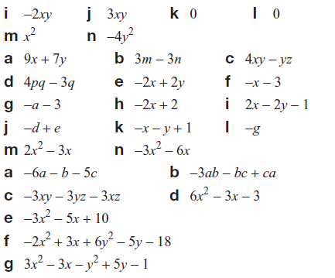
Answers

Slide 12
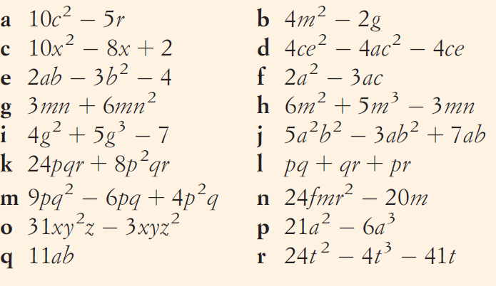
Answers

Slide 13
Notes Review
24, 7 ,30
Date
Title
Essential question
Notes complete
Notes complete with colour and diagrams
Questions completed
Contents page filed in
Formula page filled in

Slide 14
Homework
Review your notes and write a summary answering the essential question.

